Slide 1
Capacity of Small Groups of Muscles to Accomplish Precision Grasping Tasks
Joseph Towles
Assistant Scientist
Department of Mechanical Engineering
University of Wisconsin-Madison
Francisco Valero-Cuevas
Professor
Division of Biokinesiology
Department of Biomedical Engineering
University of Southern California
35th Annual International Conference of the Engineering in Medicine and Biology Society
Vincent Hentz
Emeritus Professor
Department of Orthopedic Surgery
Stanford University
Notes:
Abandoned outline-
OI is measurement outcome (stats below)
Determine substantial overlap for each precision grasp by computing the upper quartile of OI distribution for each precision grasp (box plots)
Determine the key muscles for producing force in each precision pinch area (custom algorithm – explain simply in talk may with an example)
…
…
…
ddlfjdj
dl;dfj…
Muscle Function (muscle endpoint forces) to muscle group behavior (EFD)
Evaluation of muscle group behavior
Compare EFD to idealized EFD
Quantify area of overlap between EFD and idealized EFD
Compute OI (measurement outcome) – ratio of area of overlap and area of muscle group EFD

Slide 2
Introduction

Slide 3
Introduction
Rehabilitation and surgical techniques are commonly performed to restore function to the upper limb following neurologic impairment (stroke, CP, SCI).
Botulinum Toxin Type A
Task-specific Movements
Simpson DM et al. (1996)
Bhakta JA et al. (1996)
Brasher A et al. (2002)
Slawek J et al. (2005)
Dejong SL (2011)
Muscle Stretching/Arm Support
Seo NJ et al. (2009)
Tendon Transfer Surgery
House JH et al. (1992)
TMS/tDCS
Kobayashi M et al. (2004)
Khedr EM et al. (2013) (2nd ref also)
NMES/Assisted Movement Therapy
Kamper DG et al. (2006)
Fischer et al. (2007)
-Update Refs
-Add CIT, TMS, task-specific repetitive movements examples

Slide 4
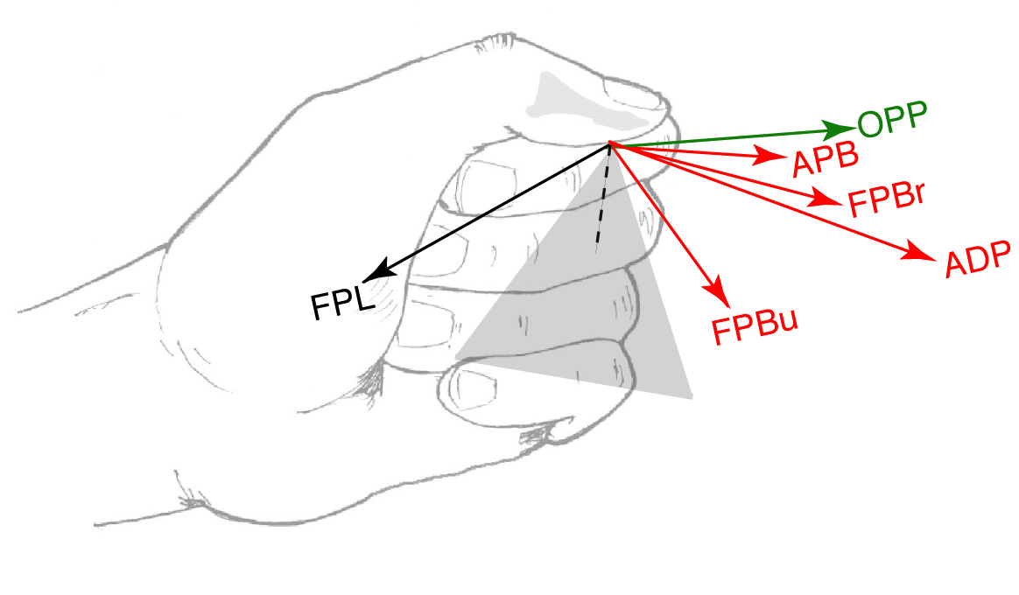
Introduction
In the particular case in which effort is made to restore the ability to grasp, there is the additional challenge of predicting grasp force that permits slip-free/stable grasp.
Endpoint forces that digit muscles produce, which contribute to grasp force, are sometimes counter-intuitively directed and thus difficult to predict.
Sagittal Plane
Thumb Flexors Muscles
-uniarticular
-biarticular
-triarticular
“flexon forces”
Thumb flexors do not produce thumb “flexion forces”
Towles, JD et al. 2008

Slide 5
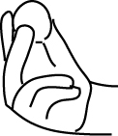
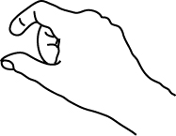
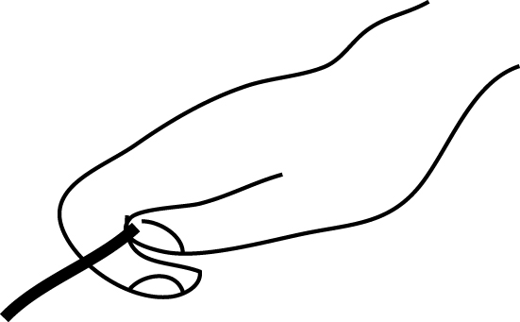
Introduction
The impression from the literature is that the best approach to restore hand function following a neurologic deficit is still an open question (DeJong SL et al., 2011; Dobkin BH, 2004; Wu C et al., 2011; Hsieh Y et al., 2011).
Complex biomechanical function of muscles possible factor?
An improved understanding of the biomechanical function of muscles as it relates to performing grasping tasks can serve to enhance current rehabilitative and surgical techniques and serve as guide to clinicians
Precision Grasping Tasks
Tripod Pinch
Tip Pinch
Lateral Pinch
This would be particular helpful in the frequent cases where one has to try to maximize function with a subset of muscles

Slide 6
Introduction
Accordingly, the goals of the study were:
Goals
Application
To determine which muscle groups enable performance of a given grasping task
To determine the relative importance or influence of muscles to accomplish a given grasping task
These muscle groups could be the ones that are targeted for surgical or rehabilitative intervention when optimizing intervention for a given precision grasp
If it were only possible to restore function to one muscle, which one would it be?
We limit our focus to the index finger as an example and because of its primary involvement in a range of grasping tasks.

Slide 7
Methods

Slide 8
Methods
In-situ characterization of index finger muscle function
Mathematical simulation and evaluation of how well muscle groups enable performance of precision grasping tasks
Precision Grasping Tasks
Tripod Pinch
Tip Pinch
Lateral Pinch

Slide 9
Characterization of Index Finger Muscle Function

Slide 10
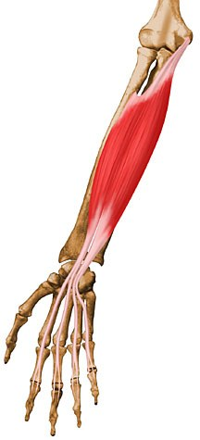
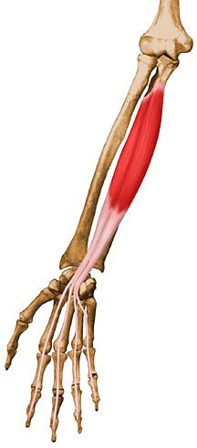
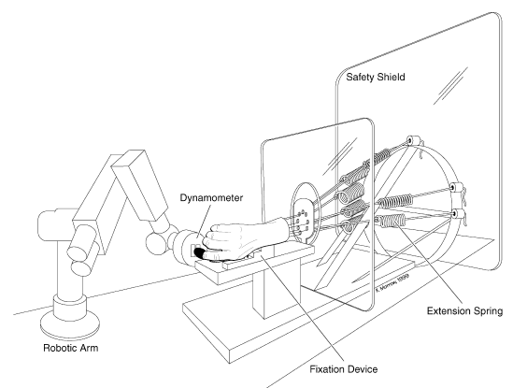
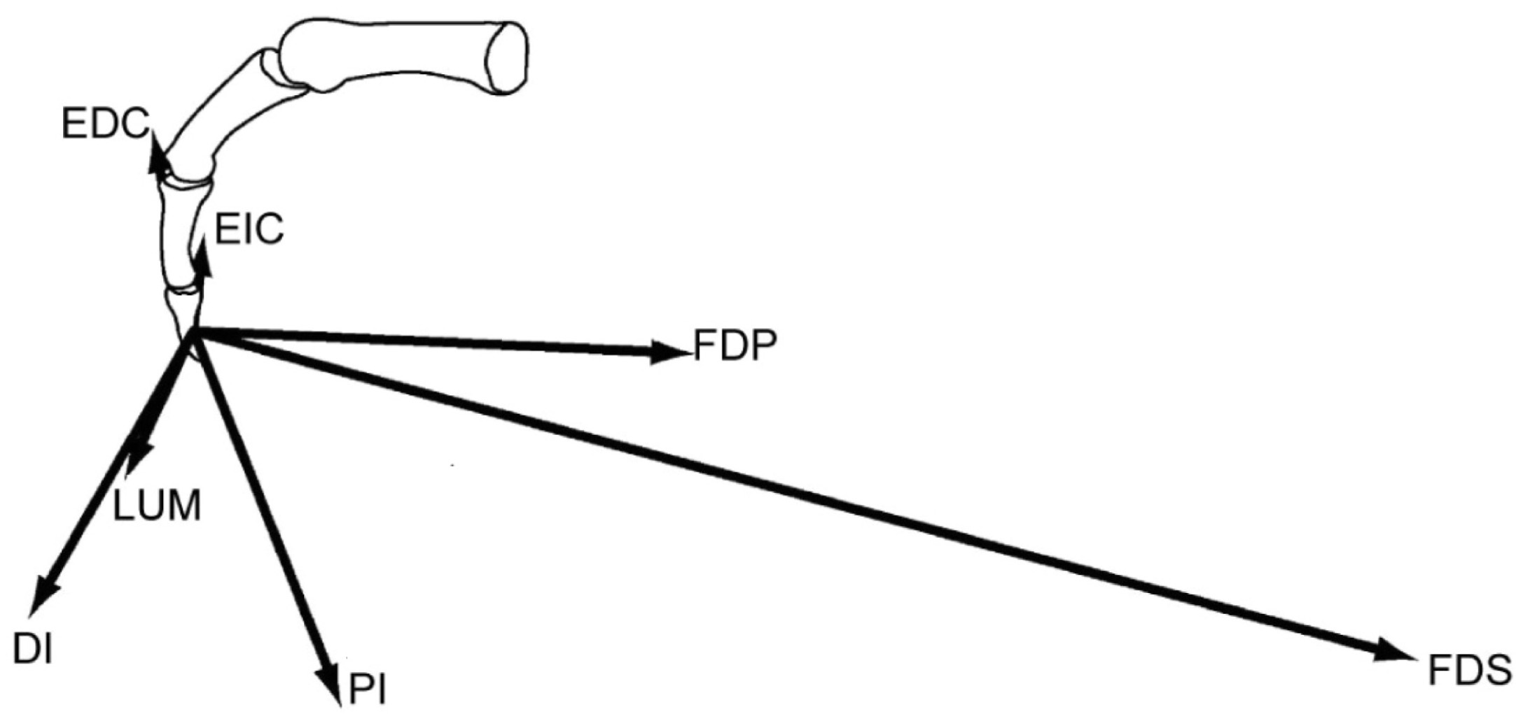
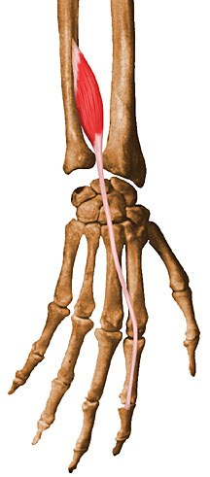
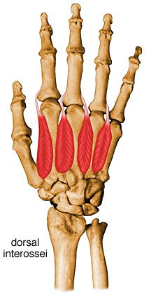
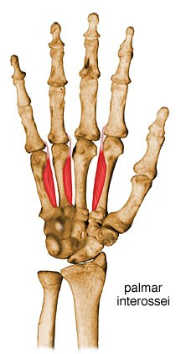
Methods Characterization of Index Finger Muscle Function
We characterized the biomechanical function of muscles of index finger in a function flexed posture
Muscle Dissections
Testing of Cadaveric Fingers
Muscle Function
FDS
FDP
EDC
Each specimen mounted on testing jig in desired posture
Index finger coupled to 6-axis load cell
Range of forces applied to each tendon (0 to 25% of max isometric force for each muscle) and endpoint force was measured
Muscle endpoint forces when max tendon forces were applied
EIP
DI
PI
Lumbrical not shown
Cadaveric specimens (n=11) were dissected to expose the 7 index finger muscles
Valero-Cuevas et al. (2000)

Slide 11
Simulation and Evaluation of Muscle Group Function

Slide 12
Methods Overview
We mathematically simulated and evaluated the potential of index finger muscle groups to accomplish precision grasping tasks
Precision Grasping Tasks
Tripod Pinch
Tip Pinch
By performing the following steps
Created muscle groups of various sizes from the 7 index finger muscles
Computed the range of endpoint forces (endpoint force distribution) that each muscle group could produce given individual endpoint force of each muscle
Evaluated the endpoint force distribution (EFD) with respect to task requirements of performing a particular grasping task

Slide 13
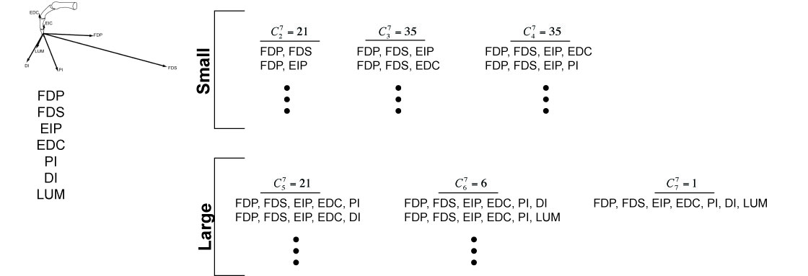
Methods Formation of Muscle Groups
Muscle Function
Muscle Groups
120 muscle groups were formed from 7 index finger muscles
21 consisting of 2 muscles
35 consisting of 3 muscles…

Slide 14
Methods Overview
We mathematically simulated and evaluated the potential of index finger muscle groups to accomplish precision grasping tasks
Precision Grasping Tasks
Tripod Pinch
Tip Pinch
By performing the following steps
Created muscle groups of various sizes from the 7 index finger muscles
Computed the range of endpoint forces (endpoint force distribution) that each muscle group could produce given individual endpoint force of each muscle
Evaluated the endpoint force distribution (EFD) with respect to task requirements of performing a particular grasping task

Slide 15
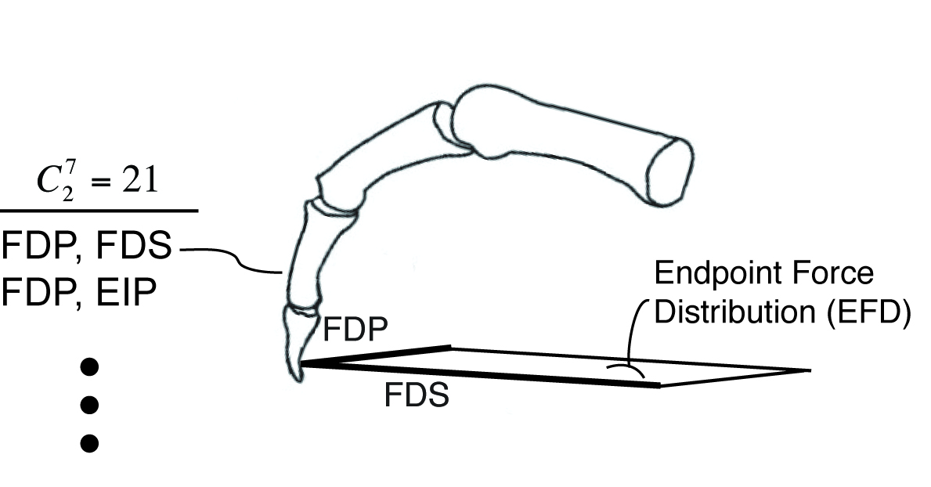
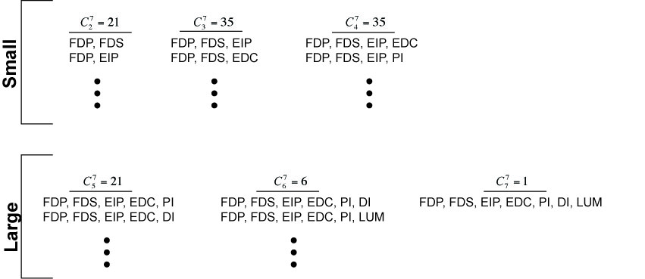
Methods Computation of Endpoint Force Distributions (FFSs)
Computational geometry (MATLAB [MathWorks, Natick MA], convexhull function) used to calculate the feasible force set for each muscle group which, in this study, we refer to as endpoint force distribution (EFD) (Valero-Cuevas et al., 2005)
EFD defined as totality of all possible resultant endpoint forces given the actions of these muscles.

Slide 16
Methods Overview
We mathematically simulated and evaluated the potential of index finger muscle groups to accomplish precision grasping tasks
Precision Grasping Tasks
Tripod Pinch
Tip Pinch
By performing the following steps
Created muscle groups of various sizes from the 7 index finger muscles
Computed the range of endpoint forces (endpoint force distribution) that each muscle group could produce given individual endpoint force of each muscle
Evaluated the endpoint force distribution (EFD) with respect to task requirements of performing a particular grasping task

Slide 17
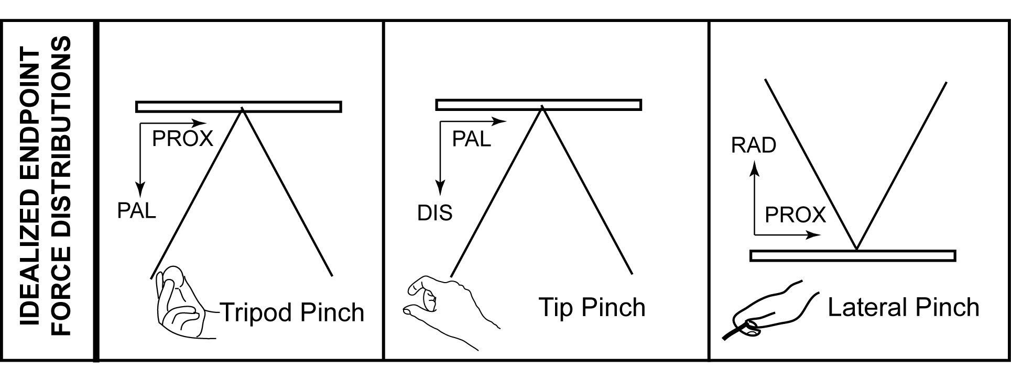
Methods Idealized Endpoint Force Distributions
EFDs were evaluated against idealized planar endpoint force distributions, friction cones (Murray et al., 1994), associated with each of the precision grasping tasks

Slide 18
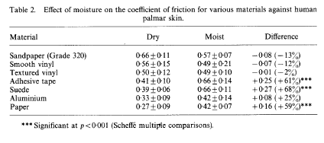
Methods Friction Cone
Measure of static friction coefficients between the palmar skin (thumb pad) and various materials
T
30 deg
Adapted from Buchholz et al. 1985

Slide 19
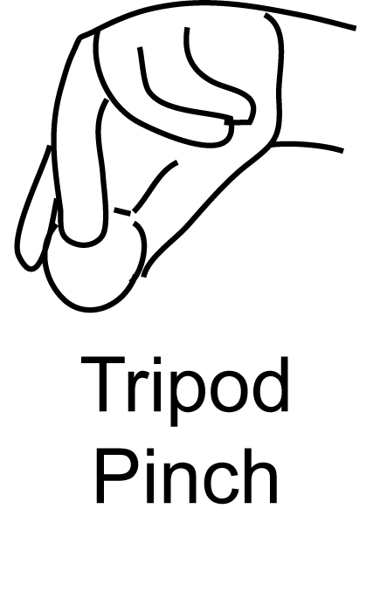
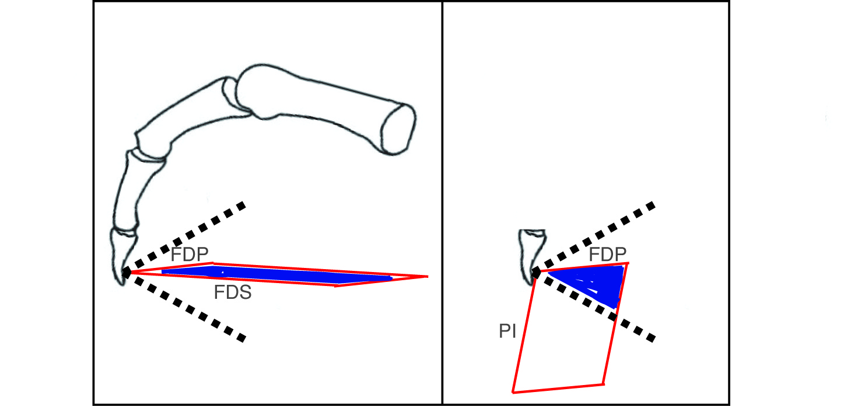
Methods Calculation of Overlap Index (OI)
Examples of OI Calculations
1
2
OI = 0.24
A_{o}
A_{mg}
OI = 1
A_{o}
Idealized EFD
A_{mg}
Overlap index – measure of intersection between muscle group EFD and idealized EFD
OI represents the extent to which muscle group produce functionally relevant forces for a given grasping task

Slide 20
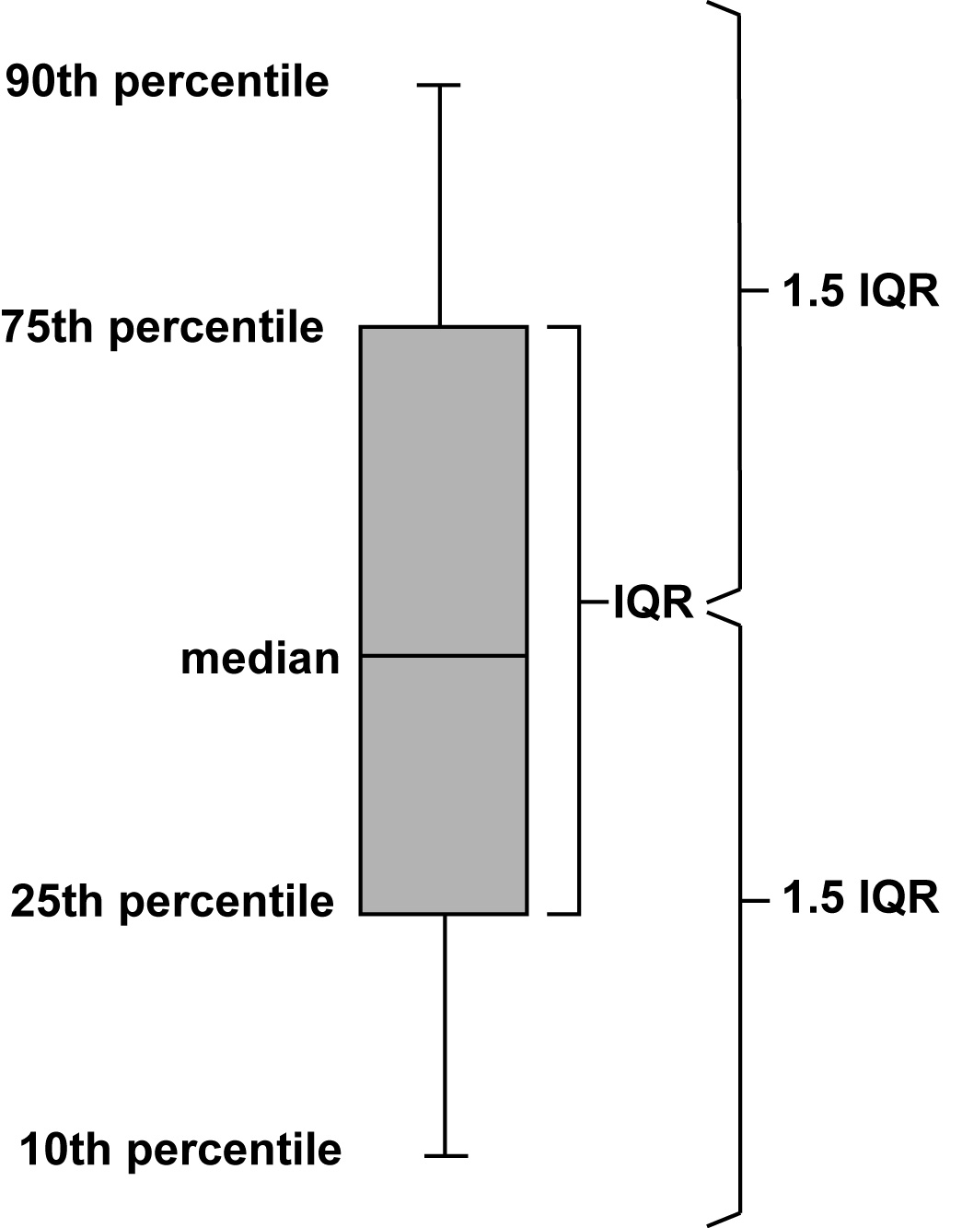
Methods Data Analyses
Example Box Plot of OIs
Finding “best” muscle groups
Computed box plots for distribution of OIs for each grasping task
Defined the upper quartile range as the pool of muscle groups with the greatest potential to satisfy force requirement of tripod or tip pinch task
Finding “best” muscle
Custom ranks-based algorithm designed to estimate the change in overlap index for when a given muscle is added to a group

Slide 21
Methods
Only present cases for first 3 muscle groups
Present one force direction – different from fuller treatment in abstract
Notes:
In the abstract, we presented results for 3 grasping tasks and all 6 muscle groups, but in the interest of time, we’ll only present results for one grasping task and 3 muscle groups consisting of 2, 3, and 4 muscles.

Slide 22
Results
Notes:
Abandoned outline-
OI is measurement outcome (stats below)
Determine substantial overlap for each precision grasp by computing the upper quartile of OI distribution for each precision grasp (box plots)
Determine the key muscles for producing force in each precision pinch area (custom algorithm – explain simply in talk may with an example)
…
…
…
ddlfjdj
dl;dfj…
Muscle Function (muscle endpoint forces) to muscle group behavior (EFD)
Evaluation of muscle group behavior
Compare EFD to idealized EFD
Quantify area of overlap between EFD and idealized EFD
Compute OI (measurement outcome) – ratio of area of overlap and area of muscle group EFD

Slide 23
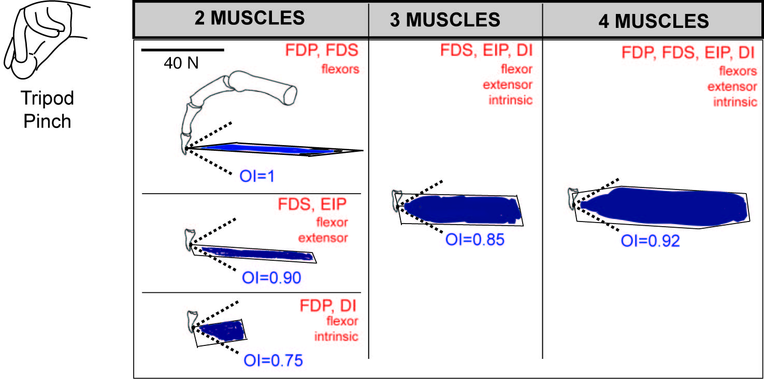
Results
Which muscle groups have greatest potential for accomplishing tripod pinch?
Numerous muscle groups (25 of 91) that enabled performance of tripod pinch
OIs relatively large
Muscle groups consist of various combinations of flexor, extensor, intrinsic muscles
Notably PI was never used

Slide 24
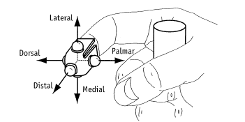
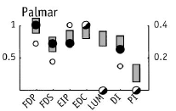
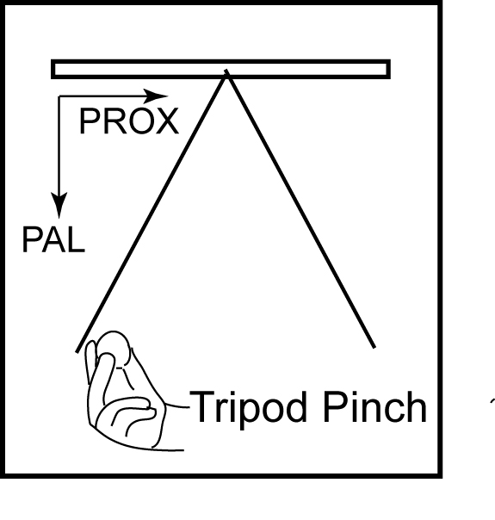
Results
Measurement of Muscle Coordination During Max Palmar Force Production
Palmar Force Production
Normalized EMG
Muscle coordination consists of combinations of flexor, extensor and intrinsic muscles at similar muscle activation levels
Low PI activity
Valero-Cuevas et al. 1998

Slide 25
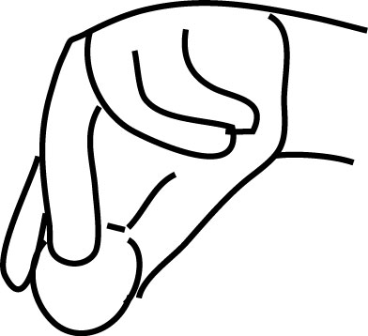
Results
Which muscle is the most important to accomplish tripod pinch?
Relative Importance of Individual Muscles for Performing Tripod Pinch
TRIPOD PINCH
FDP
FDS
EIP
EDC
DI
LUM
PI
Decreasing order of relative importance
Kutch et al., 2011

Slide 26
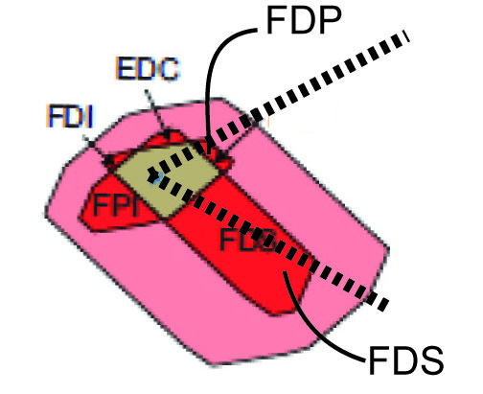
Results
Which muscle is the most important to accomplish tripod pinch?
Relative Importance of Individual Muscles for Performing Tripod Pinch
TRIPOD PINCH
FDP
FDS
EIP
EDC
DI
LUM
PI
Decreasing order of relative importance
Kutch et al., (2011) showed that FDP/FDS activity important to tripod pinch.
Our findings agree.
Endpoint force distribution displaying areas in which actions of muscles are necessary
Kutch et al., 2011
Kutch et al., 2011

Slide 27
Discussion

Slide 28
Discussion
Why is this important
Muscle function is complex
Any effort to clarify muscle function and how they may or may not contribute to precision grasp could be used to enhance current rehabilitation and surgical interventions that are capable of targeted specific muscles (botox, NMES)
Future Study
Secondary effects
Movement control
Finger contact
3D evaluation
Application to other digits, postures
This is a starting point, demonstrates an analytical approach that could be used to improve effort to restore precision pinch following neurologic impairment.

Slide 29
References
Simpson DM et al. (1996). Botulinum Toxin Type A in the Treatment of Upper Extremity Spasticity. Neurology 45(5): 1306-1310.
Bhakta BB et al. (1996). Use of Botulinum Toxin in Stroke Patients with Severe Upper Limb Spasticity. Journal of Neurology, Neurosurgery & Psychiatry 61(1): 30-35.
Brasher A et al. (2002). Intramuscular Injection of Botulinum Toxin for the Treatment of Wrist and Finger Spasticity after a Stroke. New England Journal of Medicine 347(6): 395-400.
DeJong SL, et al. 2011. Need for Speed: Better Movement Quality During Faster Task Performance. Neurorehabilitation and Neural Repair 1-12.
Slawek J et al. (2005). Botulinum Toxin Type A for Upper Limb Spasticity following Stroke: an Open-label Study with Individualised, Flexible Injection Regimens. Journal of Neurological Science 26(1): 32-39.
Fischer H et al. (2007). Hand Rehabilitation following Stroke: a Pilot Study of Assisted Finger Extension Training in a Virtual Environment. Topics in Stroke Rehabilitation 14(1): 1-12.
Kobayashi M et al. (2004). Repetitive TMS of the Motor Cortex Improves Ipsilateral Sequential Simple Finger Movements. Neurology 62: 91-98.
Khedr EM et al. (2013). Effect of Anodal versus Cathodal Transcranial Direct Current Stimulation on Stroke Rehabilitation: a Pilot Randomized Controlled Trial. Neurorehabilitation and Neural Repair (epub).
House JH et al. (1992). One-stage Key Pinch and Release with Thumb Carpal-metacarpal Fusion in Tetraplegia. Journal of Hand Surgery [Am] 17(3): 530-538.
Seo NJ et al. (2009). Delays in Grip Initiation and Termination in Persons with Stroke: Effects of Arm Support and Active Muscle Stretch Exercise. Journal of Neurophysiology 101(6): 3108-3115.
Dobkin BH (2004). Strategies for Stroke Rehabilitation. Lancet Neurology 3: 528-536.
Wu C, et al. (2011). Randomized Trial of Distributed Constraint-Induced Therapy versus Bilateral Arm Training for the Rehabilitation of Upper-limb Control and Function after Stroke. Neurorehabilitation and Neural Repair 25:130-139.
Hsieh Y, et al. (2011). Effects of Treatment Intensity in Upper Limb Robot-assisted Therapy for Chronic Stroke: Randomized Controlled Trial. Neurorehabilitation and Neural Repair 25: 503-511.
Towles JD et al. (2008). Use of intrinsic thumb muscles may help to improve lateral pinch function restored by tendon transfer. Clinical Biomechanics 23(4): 387-394.
Valero-Cuevas FJ et al. (2000). Quantification of Fingertip Force Reduction in the Forefinger following Simulated Paralysis of Extensor and Intrinsic Muscles. Journal of Biomechanics 33: 1601-1609.
Buchholz B et al. (1988). An investigation of human palmar skin friction and the effects of material, pinch force, and moisture. Ergonomics 31(3): 317-325.
Valero-Cuevas FJ (2005). An Integrative Approach to the Biomechanical Function and Neuromuscular Control of the Fingers. Journal of Biomechanics 38(4): 673-684.
Murray, RM et al. (1994). Multifingered Hand Kinematics. A Mathematical Introduction to Robotic Manipulation. New York, NY, CRC Press LLC: 211-264.
Valero-Cuevas FJ et al. (1998). Large Index Fingertip Forces are Produced by Subject-Independent Patterns of Muscle Excitation. Journal of Biomechanics 31: 693-703
Kutch JJ et al. (21011). Muscle Redundancy Does Not Imply Robustness to Muscle Dysfunction.Journal of Biomechanics 44(7): 1264-1270

Slide 30
Acknowledgement
Dept. Veterans Affairs: B2785R, B1967R

